Slide 1
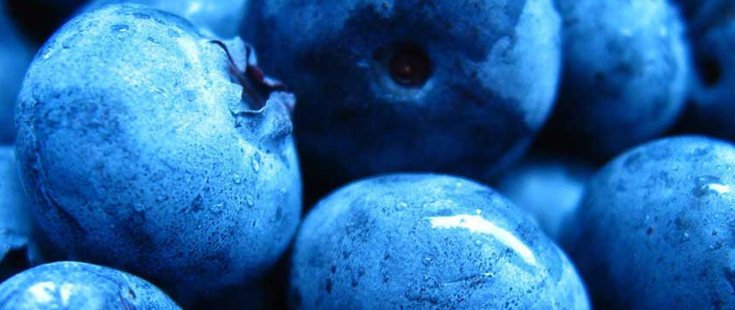
Blueberry API Excel-to-Excel communication
Bartosz Piechnik, 2015-04-16

Slide 2


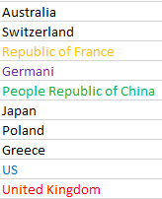




We share data between teams at ABB List of banks ABB has a relationship with
email
VLOOKUP
PROBLEM:
Several team use different versions of the same data.

Slide 3






Data owners How can we efficiently manage common data across ABB?

Slide 4
Value behind Blueberry API Project Management and Systems Engineering Team
Data is consistent and standardized accross different teams
Data is available to anyone with Internet connection – ABB teams, suppliers, clients and general public [limited by permissions assigned by the data owner]
Automatic updates of files
No need for email
No need to update files due to file name change
More to come:
Data can be manipulated before fetch

Slide 5
Compare work-flows Email + manual work vs Blueberry API
Send email
Save file to hard drive
Update links
Manual processing
Publish
Fetch
Crunch

Slide 6
Email + manual What is the most time-consuming part of preparing a report?
Send email
Save file to hard drive
Update links
Data crunching
5 min
2 min
1 min
60 min
Probably this is where the most value lives.
These processing steps are services.

Slide 7
Data crunching times Email + manual work vs Blueberry API
Daily
Monthly
Quarterly
5 reports, 45” each
TOTAL: 3h 45”
11 reports, 45” each
TOTAL: 8h 15”
8 reports, 45” each
TOTAL: 6h

Slide 8





Blueberry API Workflows
Filter
Sort
Vlookup
Merge
Format
Publish
Fetch
Crunch
Apply formula
Remove duplicates
Group/ungroup
Create charts

Slide 9


